Slide 1
SMART STREET
PRESENTERS:
ASWATH S
MOHAMED ANAS
HENSILIN RITHISTA S
SIYAM A G
PRAISAN SMITH
MAYURESH ROHIT

Slide 2
TABLE OF CONTENTS
01
02
03
SENSORS
DISPLAYS
CIRCUIT

Slide 3
INTRODUCTION
The Internet of Things These Days Is Quite Popular In The Development Of Different Low-Cost Systems With The Help Of A Microcontroller. Main Aim Of The Internet Of Things Is To Conserve Energy By Reducing Wastage Of Electricity And Also To Reduce Labor Force Or Manpower. Streetlights Are Quite An Important Part Of A City Because It Helps In Giving Better Vision Of Roads And Streets At Night Time.

Slide 4
SENSORS
01
02
03
04
DHT-22
LDR light sensor
MPU-6050
PIR
Temperature and Humidity sensor
Detect and measure the amount of light.
Accelerometer and gyroscope
Motion Sensor

Slide 5
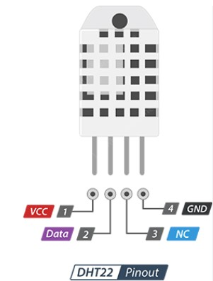
DHT-22
Operating Voltage-3 to 5V
Max Operating Current-2.5mA max
Humidity Range-0-100% / 2-5%
Temperature Range- -40 to 80°C / ± 0.5°C
Sampling Rate-0.5 Hz (reading every 2 seconds)
Body size-15.1mm x 25mm x 7.7mm
Advantage-More Accurate

Slide 6
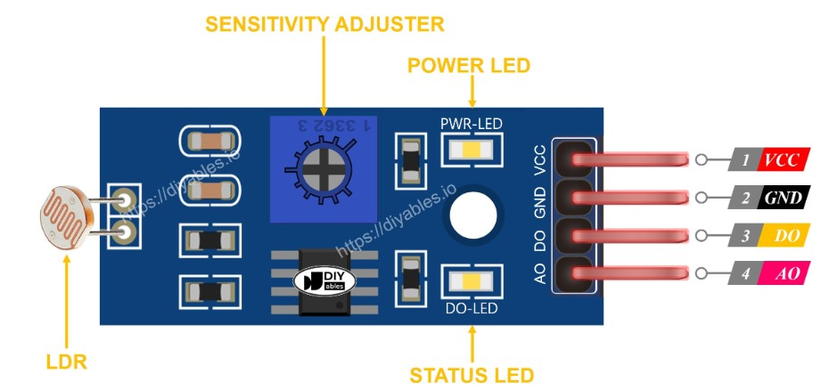
LDR light sensor
Advantage-More Accurate
Operating Voltage - 3.3V to 5V DC
Operating Current - 15ma
Output Digital - 0V to 5V, Adjustable trigger level from preset
Output Analog - 0V to 5V based on light falling on the LDR
PCB Size: 3.2cm x 1.4cm

Slide 7
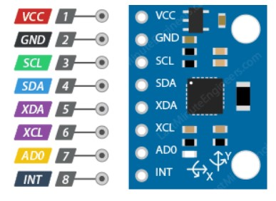
MPU-6050
Operating Voltage - 5V (typical)
Max Operating Current - less than 3.6mA
Accelerometer Range - ±2g, ±4g, ±8g, ±16g
Temperature Range - -40 to +85°C
Gyroscope Range - ±250°/s, ±500°/s, ±1000°/s, ±2000°/s
Absolute Maximum Acceleration - Up to 10,000g
Advantage - Low power consumption

Slide 8
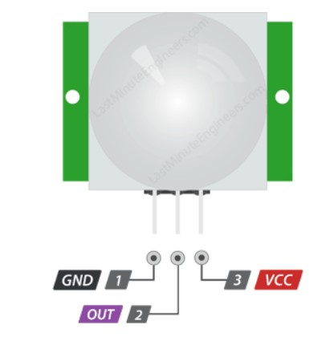
PIR
Operating Voltage - 4.5 – 20V (typically 5V)
Max Current Draw - < 2mA
Detection Distance - 3 – 7 meters (9 – 21 feet)
Detection Angle - 120 degrees (typically)
Time Delay - 1 sec to 3 min
Advantage - Low power, low cost, easy to interface

Slide 9
DISPLAY
01
02
16*2 LCD Display
I2C OLED Display

Slide 10
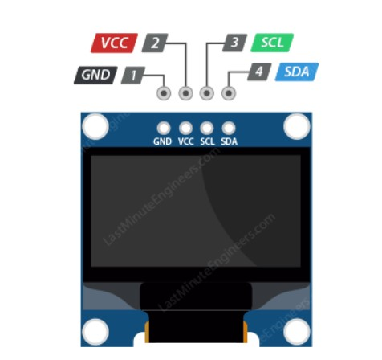
I2C OLED Display
Screen Size - 0.96 Inch Across
Screen Size - 128×64 pixels
Operating Voltage - 3.3V – 5V
Operating Current - 20mA max
Viewing Angle - 160°
Characters Per Row - 21
Number of Character Rows - 7

Slide 11
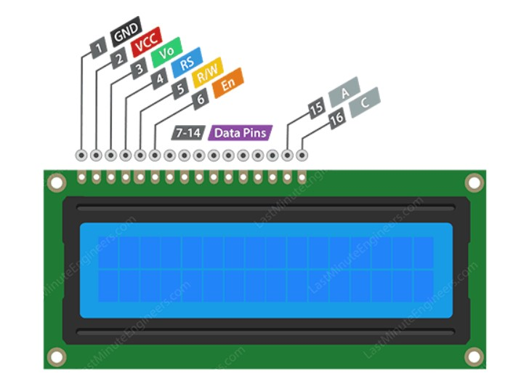
16*2 LCD Display
Screen Size - 85.0 x 29.5 x 13.5 mm
Screen Size – 32*40 pixels
Operating Voltage - 3.3V – 5V
Operating Current - 20mA max
Viewing Angle - 180°
Characters Per Row - 16
Number of Character Rows - 2

Slide 12
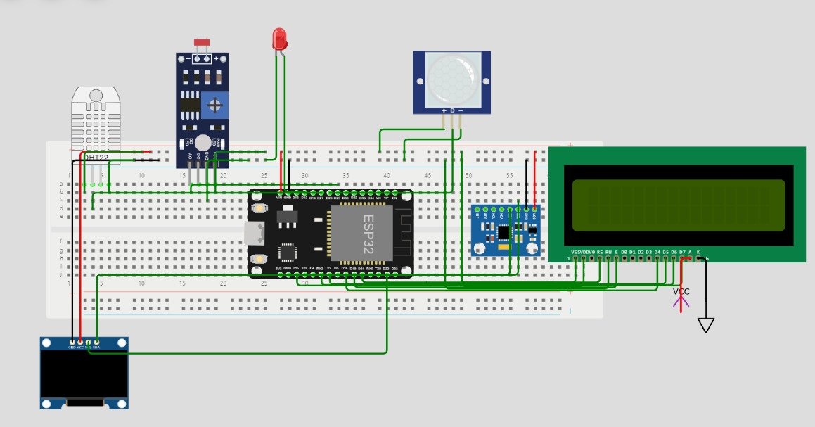
CIRCUIT

Slide 13
THANKS!

